Slide 1



ABE State Regional Session
Spring 2017

Slide 2
State ABE Staff
Todd Wagner, State ABE Director
Julie Dincau, Transitions
Cherie Eichinger, Administrative Support
Brad Hasskamp, Secondary Credential/Policy
Astrid Liden, Professional Development
Laurie Rheault, Grants
Alice Smith, GED Records/Administrative Support
Jodi Versaw, Program Quality

Slide 3
These Slides are online!
To download this presentation, go to www.mnabe.org
Click on State ABE presentations.

Slide 4
Collecting Topics & Questions
In small groups or individually, think of your key questions and topics you would like to discuss today.
Be specific with questions.
write each question down on a Post-It Note.
MDE staff will go around to collect your post-it notes.

Slide 5
Some Potential Key Topics
Professional Development
Content Standards
Federal Competitive Grant Application
WIOA
Accountability
IEL/Civics Grants
Transitions
GED
Standard Adult Diploma
Other Topics?

Slide 6
Professional Development

Slide 7
Upcoming PD Opportunities

Slide 8

Math Institute
May 4: CCRS Math Foundations
May 5: Creating Problems Worth Solving: Using CCRS to Change How Problems Are Presented
  Presenter: Connie Rivera, President of the Adult Numeracy Network and a LINCS national trainer for math and numeracy

Slide 9

Summer Institute: August 16-18
Call for proposals due April 3
Poster session proposals due May 31

Slide 10

Summer Institute:
Pre-conference workshops
Tuesday, August 15 – Wednesday, August 16
ABE Foundations
  an overview of the basics for new staff or those who need a refresher
CCRS Foundations: ELA or Math
  An overview of the standards and instructional shifts

Slide 11

Mark your calendars!
October 5-6, 2017 – CCRS Implementation Cohort Institute I
Oct 12-13, 2017- Fall North Regional
Nov 3, 2017 – Fall South Regional
January 25-26, 2018 - Language & Literacy Institute
Feb 22-23, 2018 - CCRS Implementation Cohort Institute II
April 13, 2018 – Spring South Regional
March 23, 2018 – Spring Metro Regional
April 19-20, 2018 – Spring North Regional

Slide 12

FY18 CCRS Implementation Cohort
Prerequisite = CCRS Foundations training
All future adult diploma programs will need to go through CCRS cohort training prior to launch
Program application: at least 1 administrator, 1 ELA teacher, 1 math teacher
Application available early May, due early June

Slide 13
CCRS Cohort Objectives
Program teams participating in the cohort will be able to:
  Articulate the benefits of standards-based education for their students, program, & staff
  Align materials and resources used regularly in ABE instruction
  Improve instruction and courses to incorporate shifts and standards appropriate to student levels
  Develop a long-term standards implementation plan for their local program
Administrators participating in the cohort will be able to:
  Conduct standards-focused classroom observations and teacher feedback sessions to support implementation and improve instruction
  Identify supports and resources instructors may need to implement standards-based instruction
Instructors participating in the cohort will be able to:
  Improve units, lesson plans, and student tasks to incorporate shifts and standards appropriate to student levels
  Participate in standards-focused classroom observations and teacher feedback sessions to support implementation and improve instruction

Slide 14
CCRS Cohort Activities
Kick-off webinar in September
Institute I on October 5-6, 2017
Mid-year webinar(s) in late fall/early winter (exact dates TBD)
Institute II on February 22-23, 2018
End-of-year webinar(s) in spring (exact dates TBD)
Participation in team meetings and completion of implementation tasks throughout the year at your site
Phone calls and written correspondence with an assigned ‘CCRS coach’ throughout the year as needed

Slide 15
Adult Career Pathway PD
Manager Cohort: Year-long cohort to prepare ABE managers to develop and sustain effective Adult Career Pathways programming
Instructor Cohort: Year-long focus on course design and documentation
Applications: available by early May, due in mid-June
NEW!

Slide 16

ATLAS Adult Career Pathways
Resource Library

Slide 17

Discussion: Professional Development
What questions do you have?
What issues stand out?

Slide 18

Content Standards

Slide 19
Content standards…
Describe what students should know and be able to do upon successful completion of an instructional program.
Provide the foundation for designing curricula, instruction, and assessment.
Notes:
How do we help students reach their goals? Content standards are a first step in getting there. Help us to define the end goal.

Slide 20
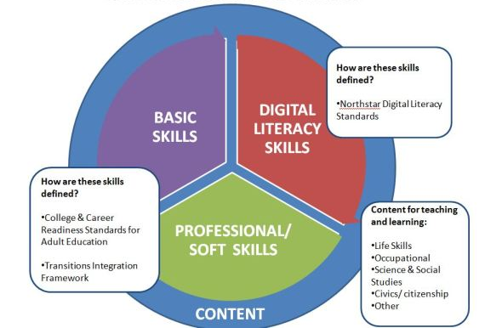
MN ABE Content Standards

Slide 21



MN ABE Content Standards
Basic Skills
CCRS
Transitions Skills
ACES TIF
Digital Literacy Skills
Northstar
Adult learners need basic academic, professional and digital literacy skills in order to succeed and thrive in post secondary education, the workplace and their communities.

Slide 22
Where did the standards come from?
College & Career Readiness Standards for Adult Education (CCRS)
  Released in 2013 by OCTAE
  Based on Common Core State Standards (CCSS)
ACES Transitions Integration Framework (TIF)
  Developed 2011-2013 by team of MN ABE practitioners and professional developers
Northstar Digital Literacy Standards
  Developed in 2010 by St. Paul Community Literacy Consortium and St. Paul Public Library

Slide 23

College & Career Readiness Standards for Adult Education

Slide 24

ELA Strands
  Reading
  Writing
  Speaking & Listening
  Foundational Reading Skills (syllables,
  phonics, word recognition, fluency)
  Language (grammar, capitalization,
  punctuation, style)
Notes:
Janet

Slide 25
Organization: ELA (ESL)
NRS Level | CASAS Reading Score | CCR Level (grade equivalent)
Beginning Literacy (ESL1) | 0-180 | A (K-1)
Low Beginning (ESL 2) | 181-190 | A (K-1)
High Beginning (ESL 3) | 191-200 | A (K-1)
Low Intermediate (ESL 4) | 201-210 | B (2-3)
High Intermediate (ESL 5) | 211-220 | C (4-5)
Advanced (ESL 6) | 221-235 | D (6-8)
Notes:
Have as a handout, have participants identify what CCRS level their learner would be according to the chart, turn to reading section –explain the level progression that happens under each anchor standard, read the leveled standard that matches the level of the learner that they just determined, underline key words, strands

Slide 26
Organization: ELA (ABE)
NRS Level | TABE Reading Score | CCR Level (grade equivalent)
Beginning ABE Literacy (ABE) | 367 & below | A (K-1)
Beginning Basic Ed (ABE 2) | 368-460 | B (2-3)
Low Intermediate Basic Ed (ABE 3) | 461-517 | C (4-5)
High Intermediate Basic Ed (ABE 4) | 518-566 | D (6-8)
Low Adult Secondary (ABE 5) | 567-594 | E (9-12)
High Adult Secondary (ABE 6) | 595 + | E (9-12)
Notes:
Have as a handout, have participants identify what CCRS level their learner would be according to the chart, turn to reading section –explain the level progression that happens under each anchor standard, read the leveled standard that matches the level of the learner that they just determined, underline key words, strands

Slide 27
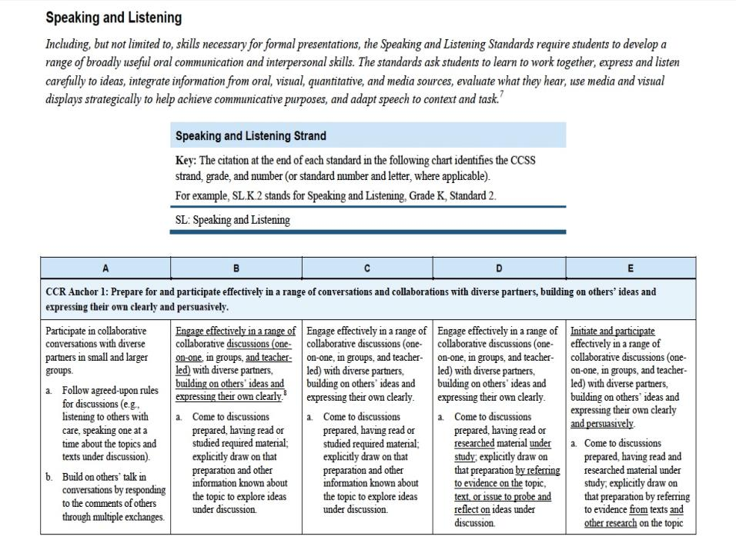
Notes:
Janet

Slide 28
Key Shifts with CCRS: ELA & Literacy
Practicing with Greater Text Complexity
Using Evidence in Answers and Analysis
Building Knowledge with Nonfiction
Notes:
These shifts identify the educational priorities in English Language and Math instruction

Slide 29
Organization: Math
The Math Practices are habits of mind to develop in your students (how students should engage in math as they grow in their expertise) – should happen across all domains
The Math Standards are leveled A-E:
Each level (A-D) has four or five domains with overarching standard statements, followed by a cluster of related standards
Level E is organized by conceptual categories, then domains, then standards, then clusters of related standards

Slide 30
Organization: Math
NRS Level | TABE Math Score | CCR Level (grade equivalent)
Beginning ABE Literacy (ABE 1) | 313 & below | A (K-1)
Beginning Basic Ed (ABE 2) | 314-441 | B (2-3)
Low Intermediate Basic Ed (ABE 3) | 442-505 | C (4-5, 6)
High Intermediate Basic Ed (ABE 4) | 506-565 | D (6, 7-8)
Low Adult Secondary (ABE 5) | 566-594 | E (9-12)
High Adult Secondary (ABE 6) | 595 + | E (9-12)
Notes:
Have as a handout, have participants identify what CCRS level their learner would be according to the chart, turn to math section and find the first page of that level.

Slide 31

CCR: Math
  Domains:
  The Number System
  Algebra
  Geometry
  Measurement & Data
  Statistics & Probability
  Functions

Slide 32
Key Shifts with CCRS: Mathematics
Focus: narrow the scope of content taught and go deeper
Coherence: Design learning around coherent progressions
Rigor: Develop
  Conceptual understanding
  Procedural skill and fluency
  Real-life application
  All with equal intensity!

Slide 33
CCRS & the ABE System
The reauthorization of the Workforce Innovation and Opportunity Act (WIOA) requires ABE to align to the CCRS and state K-12 standards.
National Reporting System (NRS) levels are being aligned to the CCRS.
Future approved NRS assessments will be aligned to the CCRS.

Slide 34
College & Career Readiness Standards (CCRS) Goals for 2016-17
Teachers & administrators will be able to articulate the benefits of standards-based education
Teachers & administrators will be able to articulate & provide examples of the key instructional shifts in ELA and Math CCRS
Teachers will be able to make instructional decisions using the key instructional shifts in ELA and Math CCRS and the Standards for Mathematical Practice, as appropriate to their teaching assignment
Teachers will be able to access the ELA and Math Standards for CCRS levels of the students they teach and summarize the key content of those levels

Slide 35
CCRS Training Sequence
Options for receiving this training:
Summer Institute pre-conference, 1 full day
ELA: Language & Literacy Institute
Math: Math Institute
CCRS Foundations online course
Options for receiving this training:
Annual CCRS Implementation Cohort:
  Two 2-day institutes (1 fall, 1 winter), kickoff & wrap up webinars, implementation tasks between meetings
  Prerequisite: Part I, CCRS Foundations for ELA or Math
After 2017: Individual training modules (workshop + follow-up) for training components
Part I
CCRS Foundations
ELA shifts: Text complexity, Evidence, Knowledge
Part II
Instructional Planning & Classroom Practice
Math shifts: Focus, Coherence, Rigor
8 Math Practices
Aligning Lessons
Aligning Resources
Aligning Student Tasks
Observing Standards-Based Lessons
Notes:
Must complete Foundations training before moving forward!

Slide 36
CCRS PD for 2017-2018
CCRS Foundations
  2017 Summer Institute Pre-Conference
  ELA Foundations at Language & Literacy Institute
  Math Foundations at Math Institute
  CCRS Foundations Online Course
CCRS workshops at conferences & regionals
CCRS Implementation Cohort (application available in May)
Booster training & ongoing support for Adult Diploma Programs

Slide 37
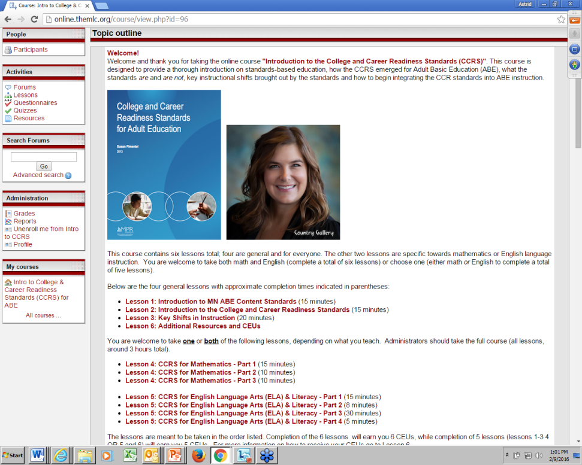
CCRS Foundations Online Course Available! http://online.theMLC.org
Content:
Introduction to MN ABE Content Standards
Introduction to the College and Career Readiness Standards
Key Shifts in Instruction
CCRS for Mathematics
CCRS for English Language Arts (ELA) & Literacy
Additional Resources
Delivery:
Online & self-paced
5-6 CEUs upon completion, depending on your needs
Notes:
Has anyone taken the course? Feedback?

Slide 38
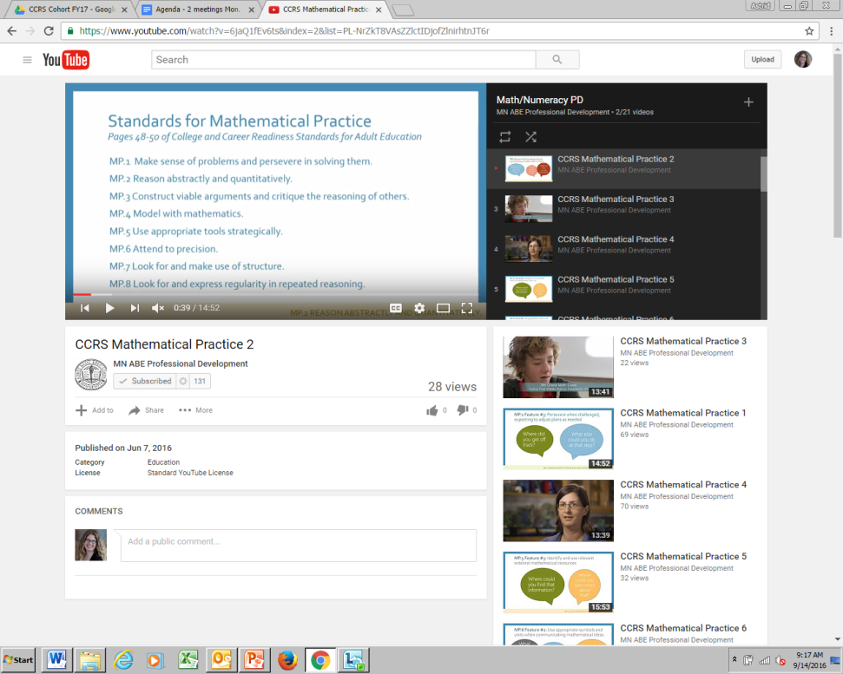
CCRS Math Practices in Practice!
Series of 8 15-min. webcasts
Each offers:
  an explanation of the highlighted Practice
  facilitation questions to ask students
  sample activities at multiple levels
  classroom videos that demonstrate the Practice
Viewing guide
Available at: http://atlasabe.org/resources/mni-toolkit/math-practices/mathematical-practice-webcast-series

Slide 39

Standards-aligned planning templates
ELA and Math Lesson/Unit Planning Templates now available on ATLAS Content Standards Resource Library:
http://atlasabe.org/resources/content-standards

Slide 40
CCRS: Your Perspectives
What are you doing to support CCRS implementation in your program?
What training have you and your staff participated in? How have you been applying what you’ve learned?
What lessons learned or resources can you share with others?
What are your next steps?
What questions do you have?
Notes:
Who has participated in CCRS Foundations? Adult Diploma CCRS training?
Small groups – 10-15 minutes (flip charts?)
Large group – report out lessons learned, resources, questions

Slide 41
CCRS: Forging your path forward
Dig into CCRS Foundations training
Focus on the shifts
Explore CCRS resources
Start using standards-aligned lesson/unit planning templates
Check out this recent ABE Connect article for ideas and links: http://atlasabe.org/mn-abe-news/ccrs-you-don-t-need-to-know-everything-to-start-doing-something
Notes:
Suggestions for exploring CCRS at the local level:
-online course as a team, use discussion questions and application assignments as activities for staff meetings, PD days, or PLC meetings
This is going to be a long process
Don’t recreate the wheel

Slide 42
CCRS Resources
ATLAS Content Standards page: http://atlasabe.org/professional/content-standards
ATLAS Resource Libraries: http://atlasabe.org/resources-atlas-and-general-abe
LINCS CCRS resource library: https://lincs.ed.gov/professional-development/resource-collections/by-topic/College%20and%20Career%20Standards
MN ABE Connect Newsletter articles: http://atlasabe.org/e-newsletters
Teaching the Core: http://www.teachingthecore.org/
Achieve the Core: http://achievethecore.org/
EngageNY: https://www.engageny.org/common-core-curriculum

Slide 43
ACES Transitions Integration Framework

Slide 44

ACES PD for FY17
ACES 101 online course
Workshops at regionals and statewide events
Webinars for ACES leaders
Support and tools for administrators and instructional leaders
Continued expansion of ACES resource library
Connections between ACES, CCRS, and contextualized instruction (LaGuardia)

Slide 45
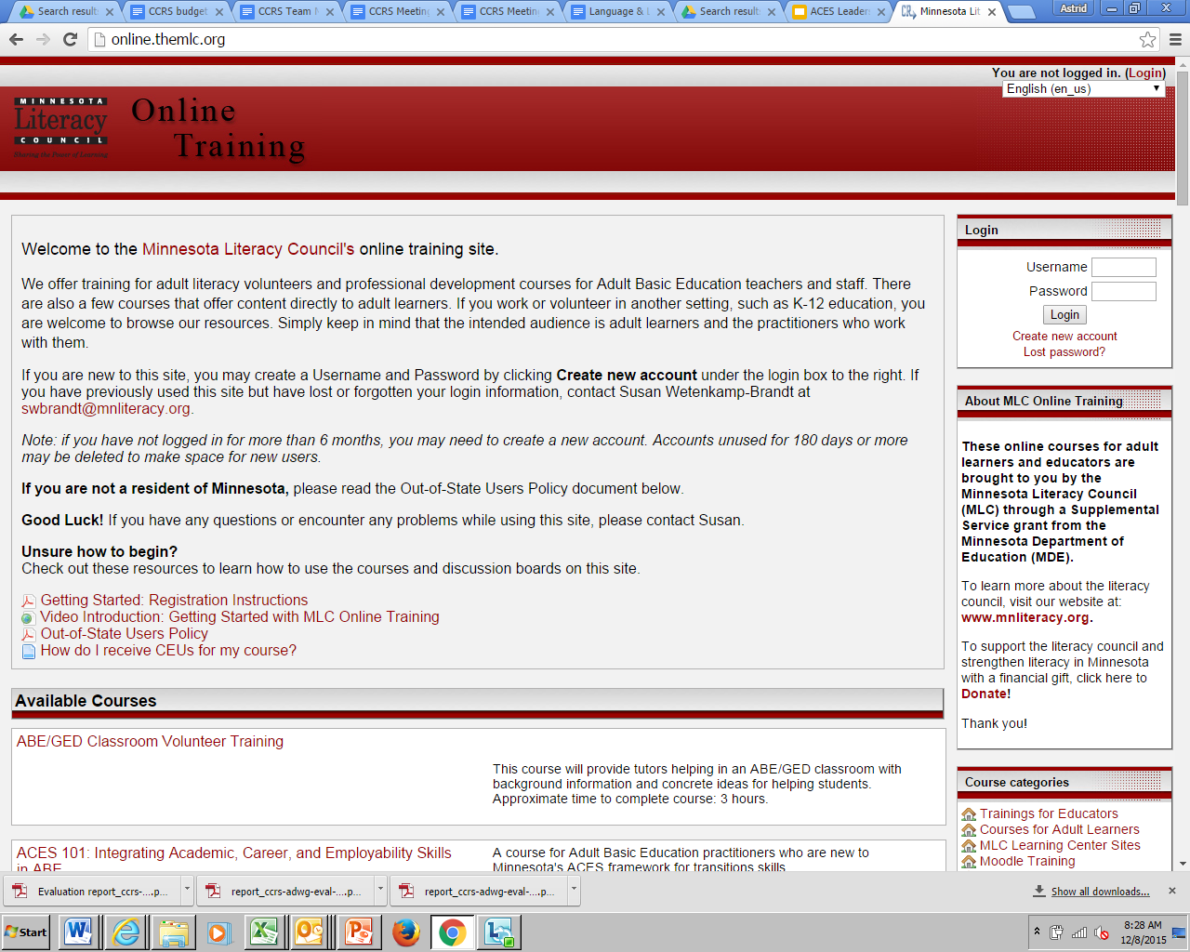
ACES 101 Course http://online.theMLC.org
Content:
MN State Standards (15 minutes)
ACES Introduction (1 hour)
6 individual ACES modules (1 hr. 30 mins each): Effective Communication, Learning Strategies, Self-Management, Navigating Systems, Critical Thinking, Developing a Future Pathway
Assessment (15 minutes)
Delivery:
Online & self-paced
CEUs upon completion, “Choose your own adventure” depending on needs!

Slide 46
ACES Tools for Instructional Leaders
ACES Facilitators Catalog
ACES Observation Tool
ACES Lesson Audit
ACES Video Companion Guides
Available at the ACES Resource Library: http://atlasabe.org/resources/aces

Slide 47
Northstar Digital Literacy Standards

Slide 48
Distance Learning & Digital Literacy
Online courses available at http://online.themlc.org
Distance Learning Basics for ABE
Digital Literacy Integration for ABE
Reminder: DL Basics or DL 101 required for all ABE managers, teachers, and support staff delivering DL
Notes:
DL Basics: 3 CEUs for support
The course provides foundational information about DL delivery. Included are seven online modules: 1) Introduction – What is Distance Learning?; 2) Curricula, Platforms, and Records; 3) Recruitment, Screening, and Orientation; Instruction; Assessment; 4) Communication and Data Collection; 5) Basic Components of Successful DL Management; 6) Statewide Resources; and 7) Final Course Assignment/Evaluation. staff, 4 CEUs for teachers, and 5 CEUs for managers.

Slide 49
Discussion: Content Standards
What questions do you have?
What issues stand out?

Slide 50

Preparing the
Federal Competitive ABE Application

Slide 51
AKA The “Re-compete”
What: Competitive federal ABE application
Due date: March 15, 2017
Applies to: All current and potential ABE consortium wanting to receive federal ABE funding
Purpose: Determines which entities receive federal ABE funding under WIOA as consortia

Slide 52

Federal ABE Competitive Grant Timeline
March 15, 2017: Re-Compete application/RFP due
March 17, 2017: MDE sends applications and forms to reviewers and to Local Workforce Development Boards
March-April 2017: Re-Compete applications reviewed
April 10-14: One-day in-person review sessions
April 24, 2017: Local Workforce Development Board feedback due to MDE
May 2017: Approved federal ABE providers announced
June 1, 2017: Accepted federal ABE provider SERVS applications due
July 2017: Accepted re-compete grantees officially launch

Slide 53

Application Narrative Questions
6 Sections (Part 4 of application)
Executive Summary
Need & Target Population
Provider Educational Capacity
Educational Quality
Collaboration & Contextualization
Program Resources

Slide 54
Section 1: Executive Summary
Describe your:
Geographic area of service or statewide special population
Brief overview of services, student population and key initiatives or partnerships

Slide 55
Section 2: Need and Target Populations
Describe the:
Specific data about the targeted population(s), noting how the program intends to serve those most in need, including individuals with low literacy and English language learners
  Census Data
  School District Data
  Other?
Evidence of need for English acquisition and civics education and how you intend to meet the need
Notes:
Discussion

Slide 56
Section 3 (A): Provider Educational Capacity
Describe the:
Evidence of past effectiveness and current capacity in improving literacy skills and outcomes for eligible adults, including individuals with low levels of literacy
  Educational level gains and outcomes
  Diploma attainment
  Postsecondary placement
  Certificate completion
  Job placement
  Other indicators?
(Used as screener by MDE and as evaluation by reviewers.)

Slide 57
Section 3 (B-D): Provider Educational Capacity
Describe the:
Evidence of ability to serve adults with disabilities
Indication of how staff meet minimal state qualifications (licensure, training and certification)
  Licensure
  ABE Foundations
  Distance Learning 101
  Other training or certification?
Evidence that staff have access to high quality professional development (PD)
  Within the ABE field
  Other forms of PD?
Notes:
Discussion

Slide 58
Section 4 (A-B): Educational Quality
Describe the:
Overview of proposed activities and services
  Align to 8 WIOA activities
  Summary of programming and schedules
Providing sufficient intensity and quality to allow students to make substantial learning gains
  Hours per week available for students at each site realistically
  Minimum hours expected of students
  Examples and evidence that these levels are sufficient

Slide 59
Section 4 (C-D): Educational Quality
Describe the:
Align to best practices derived from the most rigorous research available and appropriate
Use instructional practices that align with the essential components of reading instruction
Examples could include:
  CCRS
  ACES
  Northstar Digital Literacy
  STAR
  Other?

Slide 60
Section 4 (E): Educational Quality
Describe the:
Integration of each of the state ABE content standards
  CCRS
  ACES
  Northstar Digital Literacy
Evidence needs to include:
  Staff training
  A content standards implementation plan
  Evidence of integration of each into instruction and curriculum

Slide 61
Section 5 (A-B): Collaboration and Contextualization
Describe the:
Evidence of alignment to needs in local or regional plan, including concurrent enrollment with Title I programs
Evidence of alignment with one-stop partners
Examples:
  Plans at: www.gwdc.org/wioa/planning/index.html
  Aligned career pathway programming to priority sectors
  Concurrent enrollment promotion with WIOA Title I and other programs
  Other?

Slide 62
Section 5 (C-D): Collaboration and Contextualization
Describe the:
Description of contextualized ABE instruction and activities to build skills to complete postsecondary education, training, employment, etc.
Description of the organization’s career pathway programming (past and ongoing)
Examples:
  ACES TIF skills integration into curriculum
  Sector- and career-specific skills, curriculum and resources
  IET programming
  Other?

Slide 63
Section 5 (E): Collaboration and Contextualization
Describe the:
Programming through coordination and collaboration with other organizations
Examples:
  Organizational members of consortium
  Educational (K-12, postsecondary, other)
  Workforce (one-stops, local workforce development boards, training institutions, other?)
  Human Services (community-based organizations, nonprofits, MFIP, SNAP E & T, other?)
  Industry (business, labor, other?)
  Other?

Slide 64
Section 6 (A-B): Program Resources
Describe the:
Description of use of technology to enhance programming and increase quality of learning
Proposed schedule flexibility and coordination with support services
Examples:
  Northstar certification?
  Technology resources accessible on site?
  Distance learning and/or hybrid programming?
  Program schedule including day, evening and/or weekend programming?
  Other?

Slide 65
Section 6 (C-E): Program Resources
Describe the:
Use of state ABE database
Capacity to sustainably match federal funding
History of fiscal management procedures and audits
Examples:
  Summaries or links to UFARS audits or organizational audit records?
  Summary of record of passing government fiscal monitoring in the past?
Return to Question Slide

Slide 66
Application Review
3 Step Process
Local Workforce Development Board Review
Official Grant Reviewers
Minnesota Department of Education Review

Slide 67

Review 1A: Workforce Review Process
Workforce Development Board (WDB) feedback
Applications will be distributed to WDBs after submission to MDE
WDBs will have 4+ weeks to read and provide feedback
Feedback will be used by MDE staff to inform funding recommendations

Slide 68
Review 1B: Official Grant Review Process
Official Grant Reviewer (OGRs)
Regional review teams will include 3-4 local ABE staff from other regions, at least one state ABE staff, and one or two other representatives from partner entities
In preparation for the review, OGRs will be offered training and technical assistance from MDE.
OGRs will have an estimated 3-4 weeks to read and score applications.
During the week of April 10-14, OGRs will convene at MDE for an in-person group review at which they receive the local workforce development board application review feedback.
In the group review, OGRs will discuss individual feedback, compare results, address questions and issues, and determine a collective score and rationale.

Slide 69

Review 2: Review Process
Official funding decisions will be made by Minnesota Department of Education in May 2017, informed by:
Local WDB feedback, and
OGR recommendations and scores.

Slide 70
Discussion: Federal Competitive Application
Based on the proposal:
What questions do you have?
What issues stand out?

Slide 71

WIOA Updates
Brad Hasskamp

Slide 72
The Structure of WIOA
Law Title (Section) | Name | Program/Activities | Who oversees in Minnesota
Title I (Subtitle A) | Workforce Development Activities (System Alignment) | All WIOA Programs | DEED and MDE
Title I (Subtitle B) | Workforce Development Activities (Workforce Activities and Providers) | Adult, Youth, and Dislocated Worker Programs | DEED
Title II | Adult Education and Family Literacy Act | Adult Basic Education | MDE
Title III | Wagner-Peysar Act | Workforce Centers (One-Stops) | DEED
Title IV | Rehabilitation Act | Vocational Rehabilitation (VR) | DEED
Title V | General Provisions | All WIOA Programs | DEED and MDE

Slide 73
Individuals with Barriers to Employment
A member of one or more of the following populations:
Displaced homemakers | Ex-offenders | Long-term unemployed
Low-income individuals | Homeless individuals, or homeless children and youth | Individuals within 2 years of exhausting lifetime eligibility under the SSA, title IV part A
Indians, Alaska Natives, and Native Hawaiians | Youth who are in or have aged out of foster care | Single parents (including single pregnant women)
Individuals with disabilities, including youth | English language learners, individuals with low levels of literacy, and individuals facing substantial cultural barriers | Such other groups as the Governor determines to have barriers to employment
Older individuals | Migrant and seasonal farmworkers

Slide 74
What are adult education and literacy programs, activities and services?
Federal Regulations Citation:
CFR §463.30

Slide 75
Adult education and literacy programs, activities and services may include any of the following:
Adult education,
Literacy,
Workplace adult education and literacy activities,
Family literacy activities,
English language acquisition activities,
Integrated English literacy and civics education,
Workforce preparation activities, or
Integrated education and training.

Slide 76

WORKFORCE PREPARATION ACTIVITIES
Activities, programs, or services designed to help an individual acquire a combination of basic academic, critical thinking, digital literacy, and self-management skills
Includes competencies in utilizing resources and using information, and acquiring other skills necessary for successful transition into postsecondary education, training, or employment
Connections with ACES Transitions Integration Framework

Slide 77

INTEGRATED EDUCATION AND TRAINING
Service approach that provides adult education and literacy activities concurrently and contextually with workforce preparation activities and workforce training that targets training for a specific occupation or cluster that assist adults in their educational and career advancement

Slide 78
Integrated Education and Training (IET) must be part of a Career Pathway
Career Pathways (Sec. 3(7)) is a combination of rigorous and high-quality education, training and other services that:
Aligns with skill needs of the state’s or regional industries,
B. Prepares an individual to be successful in a range of sec. or post-sec. education,
C. Includes counseling to support an individual’s education and career goals,
D. Includes education offered concurrently and contextually with workforce preparation and training in a specific occupation or cluster,
E. Organizes education, training and other services to meet and accelerate an individual’s educational and career advancement,
F. Enables an individual to attain a secondary school diploma or its recognized equivalent, and
G. Helps an individual enter or advance within specific occupation or occupational cluster.
Notes:
The Career Pathway definition is on page 1 in your definitions packet in your folder.

Slide 79


INTEGRATED ENGLISH LITERACY AND CIVICS EDUCATION
Provides instruction in:
Literacy and English language acquisition,
Civic participation and the rights and responsibilities of citizens,
Workforce preparation and
Workforce training
Activities must be provided in combination with IET activities
Focuses program design and goal on preparing adults for employment in in-demand industries and in coordination with local workforce system

Slide 80
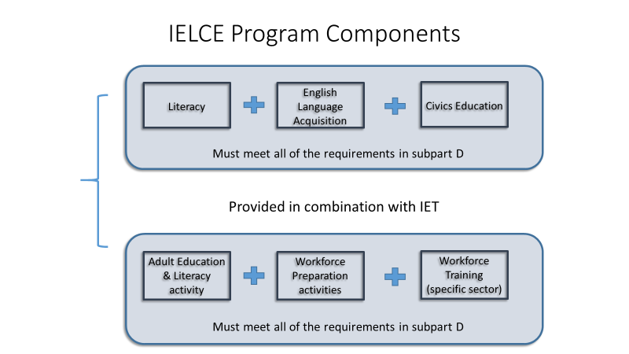
Program Model (IEL/Civics) Go to Questions or IEL/Civics Grant

Slide 81


WIOA Info On the Web
MNABE Law, Policy and Guidance site (www.mnabe.org)
U.S. Education Department AEFLA site (www2.ed.gov/aefla)

Slide 82
Discussion: WIOA
What questions do you have?
What issues stand out?

Slide 83
Accountability
Revamping the NRS

Slide 84
Accountability
Performance Measures
NRS Tables
Additional Changes

Slide 85

Key Changes

Slide 86
Program Entry and Exit
Program Entry- is the date that a reportable individual enrolls in an adult education and family literacy program.
Program Exit - As defined for the purpose of performance calculations, exit is the point after which a participant who has received services through any program meets the following criteria: For the adult, dislocated worker, and youth programs authorized under WIOA title I, the AEFLA program authorized under WIOA title II, and the Employment Service program authorized under the Wagner-Peyser Act, as amended by WIOA title III, exit date is the last date of service. **The last day of service cannot be determined until at least 90 days have elapsed since the participant last received services; services do not include self-service, information-only services, activities, or follow-up services. This also requires that there are no plans to provide the participant with future services.
Notes:
Does this mean that a student who tells the program that they are not returning can’t be exited from the program until 90 days have passed?
The rule did not have language regarding program entry.
Exit is calculated after 90 days has passed. However, the date is retroactive back to the last date of attendance.

Slide 87
Employment Performance Indicators
Employment, the second quarter after exit: The percentage of participants who are in unsubsidized employment during the second quarter after exit.
Employment, fourth quarter after exit: The percentage of participants who are in unsubsidized employment during the fourth quarter after exit.
Median Earnings, second quarter after exit: Median earnings of participants who are in unsubsidized employment during the second quarter after exit from the program.

Slide 88
Credential Attainment Indicator (Rule)
The percentage of those participants enrolled in an education or training program (excluding those in on-the-job training [OJT] and customized training) who attained a recognized postsecondary credential or a secondary school diploma, or its recognized equivalent, during participation in or within 1 year after exit from the program.
A participant who has attained a secondary school diploma or its recognized equivalent is included in the percentage of participants who have attained a secondary school diploma or recognized equivalent only if the participant also is employed or is enrolled in an education or training program leading to a recognized postsecondary credential within 1 year after exit from the program;

Slide 89
Credential Attainment Indicator (Joint ICR)
Who Counts?
The Secondary Credential attainment measure is limited to participants who exit AND began the program year at or above the 9th grade level who did not previously possess a high school equivalency.
The Postsecondary Education attainment measure is limited to participants who exited and were enrolled in either a postsecondary education or training program.
Notes:
Do we have 2 years on postsecondary Ed?
Further Define type of credential. i.e. postsecondary leading to… Pulled from the PIRL 1800
1 = Secondary School Diploma/or equivalency
2 = AA or AS Diploma/Degree
3 = BA or BS Diploma/Degree
4 = Graduate/Post Graduate
5 = Occupational Licensure
6 = Occupational Certificate
7 = Occupational Certification 8 = Other Recognized Diploma, Degree, or Certificate
0 = No recognized credential
Any exclusions other than Sec. 225?

Slide 90
Measurable Skill Gain Indicator
The percentage of participants who, during a program year, are in an education or training program that leads to a recognized postsecondary credential or employment and who are achieving measurable skill gains, defined as academic, technical, occupational, or other forms of progress, towards such a credential or employment.

Slide 91
5 Types of Measurable Skill Gain
Measurable Skill Gain
Secondary Diploma/ Equivalent
Progress toward Milestones
Secondary or Post-Secondary Transcript
Program Exit + Entry into Postsecondary Education
Educational Functioning Level Gain
Pre-Post Test
Completion of Carnegie Units
Passing Technical / Occupational Knowledge Based Exam
Used in Title II

Slide 92
Periods of Participation
For the purposes of reporting measurable skill gain, each program entry per participant during the reporting period is considered a period of participation. For the purposes of reporting on Employment 2nd Quarter, Employment 4th Quarter, Median Earnings, and the Credential indicators, each program entry and exit per participant during the reporting period is considered a period of participation.
A new period of participation is counted each time a participant exits and reenters again, even if it occurs during the same program year.

Slide 93
Periods of Participation (POP)
PoP 1
PoP 2
PoP 3
MSG is evaluated.
Follow-up must occur for exit-based measures.
MSG is evaluated again.
Follow-up must occur again for exit-based measures.
MSG is evaluated again.
Exit based measures are NOT evaluated because there is not an exit.
Jul 1st
Jun 30th
Program Entry/ Reentry
Program Exit

Slide 94
Participant Exclusion
For purposes of determining program performance levels under indicators set forth in paragraphs (a)(1)(i) through (iv) and (vi) of § 677.155, a “participant” does not include a participant who received services under sec. 225 of WIOA and exits such program while still in a correctional institution as defined in sec. 225(e)(1) of WIOA
Sec. 225 participants (Corrections) who remain incarcerated are only counted for the Measurable Skill Gain Indicator.

Slide 95
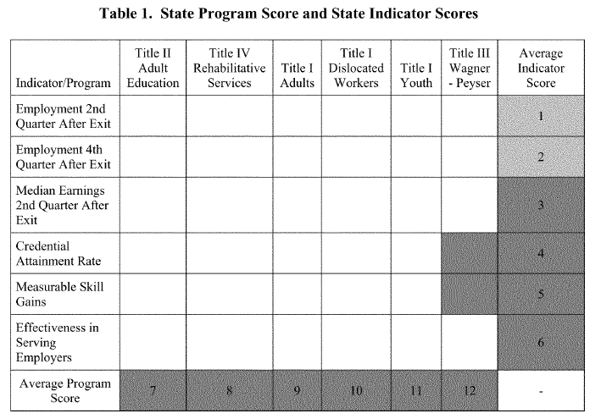
New State WIOA Performance Tables

Slide 96
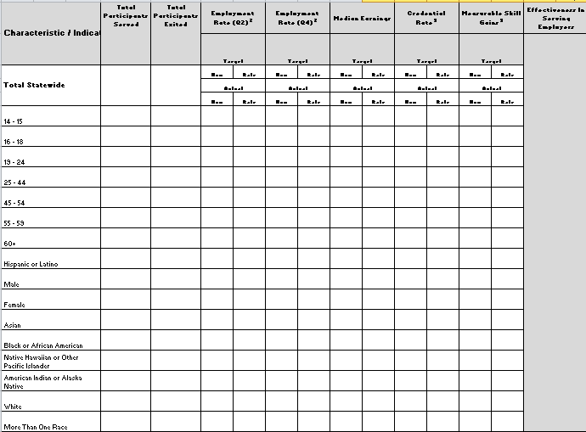
Local NRS Table Changes

Slide 97
Discussion: Accountability
Based on the federal tables:
What questions do you have?
What issues stand out?

Slide 98
INTEGRATED ENGLISH LITERACY AND CIVICS EDUCATION (IEL/Civics) GRANTS

Slide 99
IEL/Civics Tentative Grant Timeline
Mid to Late March: Applications posted on MDE Grants Site (email announcement to all current and interested ABE and IEL/Civics programs)
April 20: Applications due
April 20-May: Applications reviewed by reviewers and local workforce development boards
May-June: Grantees announced

Slide 100
IEL/Civics Programming
Provides instruction in:
Literacy and English language acquisition,
Civic participation and the rights and responsibilities of citizens,
Workforce preparation and
Workforce training
Activities must be provided in combination with IET activities
Focuses program design and goal on preparing adults for employment in in-demand industries and in coordination with local workforce system

Slide 101
Program Model (IEL/Civics) Go to Questions or IEL/Civics Grant

Slide 102
Discussion: IEL/Civics
Considering the grant:
What questions do you have?
What issues stand out?

Slide 103
Transitions

Slide 104
Navigating and Advising Support Services Grant
5 Grants Awarded:
St. Paul Community Literacy Consortium
Southwest ABE
Mankato
Southeast ABE and Hiawatha Valley ABE
Adult Academic Program - Robbinsdale
Contract end date is June 30, 2019

Slide 105
Adult Pathways to Postsecondary Webinars
On May 6th, 2016 an Adult Pathways to Postsecondary event was held at Lake Superior College.
Three mini-grants were provided to support work between ABE, Minnesota State, and Career and Technical Education.
The results of these grants were shared via webinar this winter. Archived webinars available at: http://bit.ly/2gtUHFe

Slide 106
Better Together: Libraries, ABE, and Workforce Development
Monday, May 15
Location TBD
Focus on digital literacy for low-skilled adults

Slide 107
Discussion: Transitions
What questions do you have?
What issues stand out?

Slide 108

GED® Updates
Notes:
GED Updates (Brad)
Ready Vouchers (Expiration and promotion)
Ready Promotion
Accommodations
Free Testing Promo Code

Slide 109
What’s happening with GED?
Accommodations
GED Ready Promotion
GED Ready Vouchers and Promotion
Free Testing Code
GED News

Slide 110
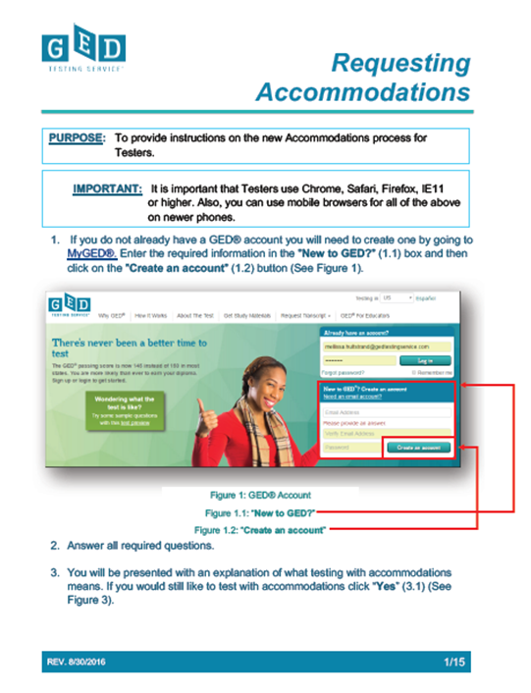
Accommodations
New online process for requesting accommodations
Step-by-step manual in resources
Can currently still use fax process

Slide 111

GED Ready Vouchers
During the week of October 17, requested GED Ready Vouchers distributed (close to 9,000!)
A few additional ones left
Use before July 1, 2017

Slide 112
What happened to Minnesota’s Free GED Code?
The funds for code “MNGED30” ran out Wednesday, March 8.
The state legislature allocated $245,000 for free GED testing (replacing the previous $125,000 that was allocated for $10 off each 1st test or $40 off each full battery).
Current proposed legislation allocates $125,000 for 2017-18 for $10 off the first test in each subject.

Slide 113

To get GED news, sign up for GED In Session and Tuesdays for Teachers!
Sign up at www.gedtestingservice.com

Slide 114
Discussion: GED
What questions do you have?
What issues stand out?

Slide 115

The Standard Adult High School Diploma

Slide 116

State Standard Adult High School Diploma Pilots In Operation (2016)
Department of Corrections (4 facilities)
Cass Lake-Bena-Walker ABE
Central Minnesota ABE (St. Cloud)
Deaf ABE
Hiawatha Valley ABE (Red Wing)
Lakeville ABE
Metro East ABE
Metro North ABE
Metro South ABE
Minneapolis Adult Education
Northwest MN ABE Region Collaborative
Osseo ABE
Robbinsdale Adult Academic Program
Rochester ABE
Southeast ABE (Faribault)
Southwest MN ABE Region Collaborative
St. Paul Community Literacy Consortium

Slide 117
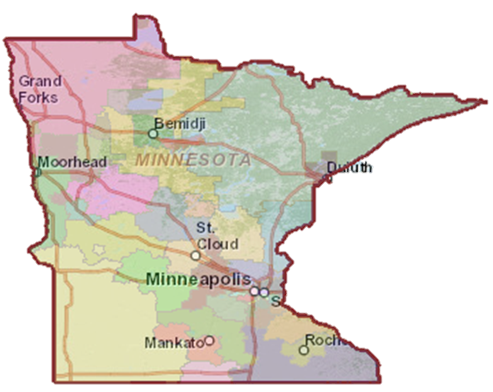

2017 Programs

Slide 118

What does that mean?
By the end of 2017, the state standard adult high school diploma will be’ implemented in 27 out of Minnesota’s 43 ABE consortia, meaning the majority of the state’s population will have access to multiple secondary credential options as adults!

Slide 119
Discussion: Standard Adult Diploma
What questions do you have?
What issues stand out?

Slide 120

Additional
Questions

Slide 121

Don’t Forget www.mnabe.org

Slide 122
Thank you for your hard work!

